Slide 1

Password Strength Checker
IT360
Amira Azouz
Iheb Zitouni
Ines Afli

Slide 2

Introduction
The web-based password strength checker is a system that enables users to assess the reliability and security of their passwords. It is designed to provide a trustworthy and secure method of evaluating password strength. However, the system requires an internet connection to function effectively.. The password strength checker may offer several key features, but taking into consideration the time and resources we have we will work on the following: the ability to input a password and receive an evaluation of its strength based on established criteria(number of characters, upper and lowercase letters, numbers, and special characters). Additionally, users can search for tips and suggestions on how to create stronger passwords or receive recommendations for password improvement.
1

Slide 3
USER SIDE :
The user can access the password strength checker through a web page or an application that includes this functionality.
The user can enter their desired password into the password strength checker input field.
The password strength checker will then perform a series of tests on the password, based on the rules and requirements set by the system. These tests can include checking for password length, and complexity.
The password strength checker will then provide feedback to the user on the strength of their password, and whether it meets the requirements set by the system.

Slide 4
If the password does not meet the requirements, the password strength checker can provide suggestions to the user on how to improve the strength of their password, such as increasing the length or complexity of the password.
The user can then revise their password based on the feedback provided by the password strength checker until they create a password that meets the system requirements.
The password strength checker provides users with a tool to help them create strong and secure passwords that are less susceptible to hacking and unauthorized access.

Slide 5
SYSTEM SIDE :
Collect password input: The user enters their desired password into an input field in the user interface of the application or website.
Hide password: the user can choose to hide the password he is entering for security purposes
Validate input: The application checks the input to ensure it meets minimum requirements, such as minimum password length or the inclusion of certain characters (upper and lowercase letters, numbers, and special characters).

Slide 6
Calculate password strength: The application calculates the strength of the password based on various factors, such as length, complexity, and the use of unique or uncommon words.
Provide feedback to the user: The application provides feedback to the user on the strength of their password and suggests ways to improve it if it is not strong enough.

Slide 7
To sum up the password strength checker can be implemented using a combination of validation, comparison, and calculation functions, along with a user interface for input and feedback. The specific implementation details will depend on the programming language, framework, and other technical requirements of the project.

Slide 8
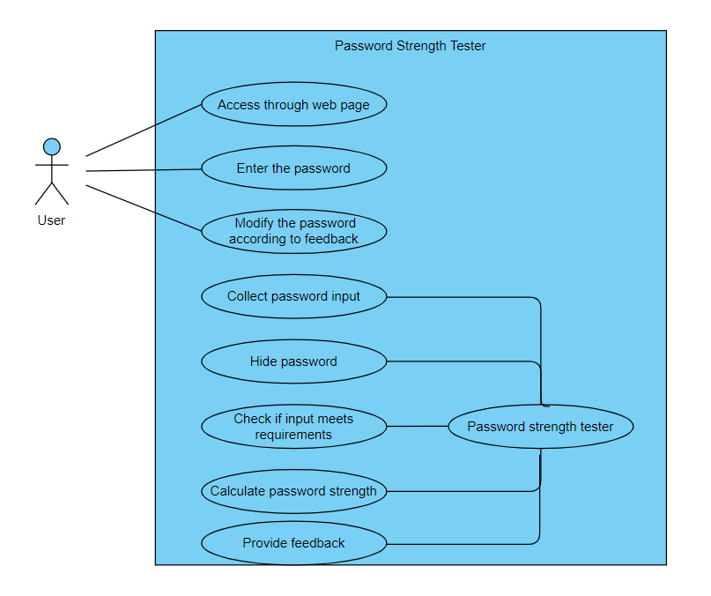
USE CASE DIAGRAM :

